Slide 1


M
VIE
BOOKING APP
PRESENTED BY - SREENISHA
KARTHIK RAJ
ADARSH
MANIKANTA
KARTHIKEYAN

Slide 2
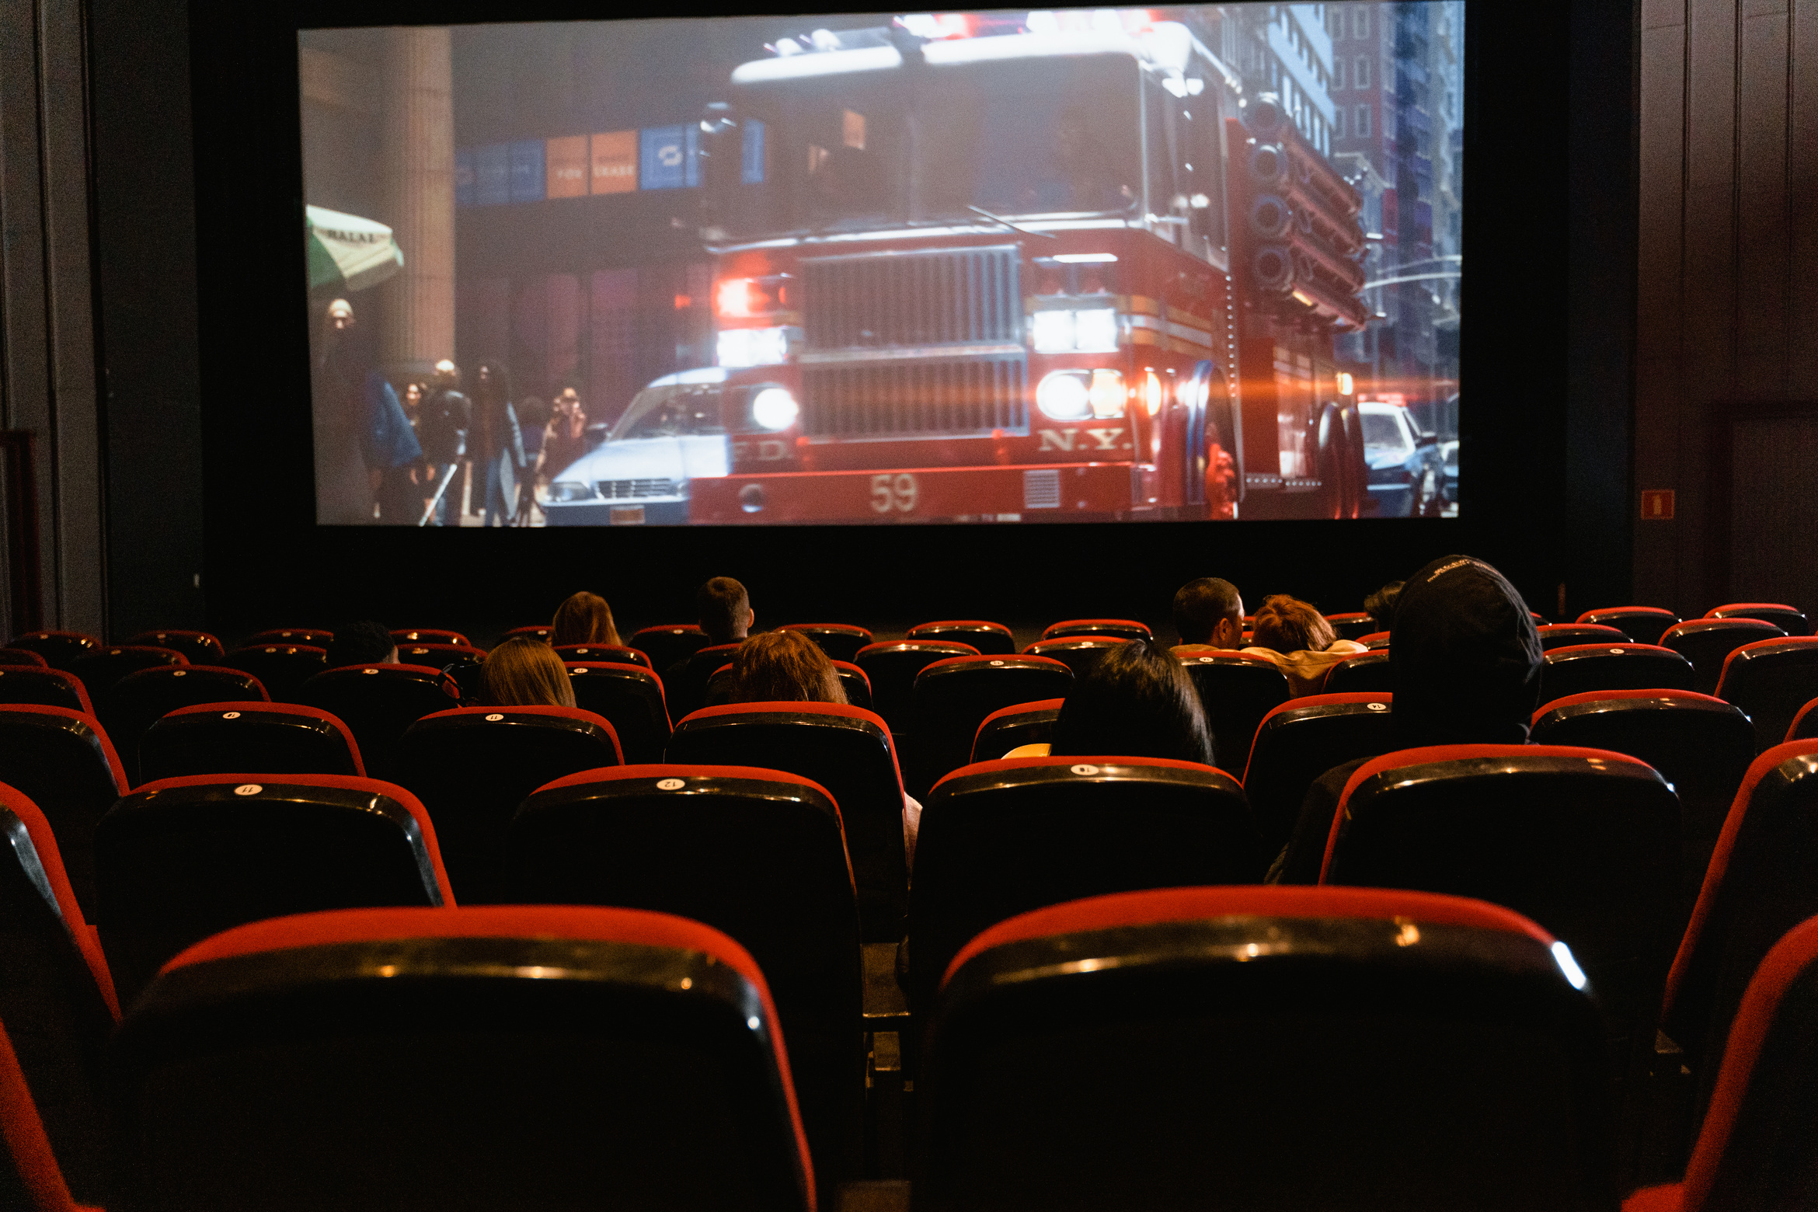
OUTLINE
Problem Statement
1
2
Objective
3
Project Overview
4
Technologies & Tools Used
5
Project Flow
6
Architecture
7
Screenshots
8
Conclusion

Slide 3



Problem Statement
X wanted to watch a movie that has recently been released they have been waiting for but X doesn’t want to manually call and check if movie is available in theaters
Y wants to add his multiplex and add movies to it but he doesn’t know where to market this information.

Slide 4


Objective
1
2
To provide a simple and fun user experience to watch your favorite movies in your select watching experience.
To provide an easy-to-use place for multiplex owners to display their information to customer.

Slide 5






Technologies Used

Slide 6





Tools Used

Slide 7
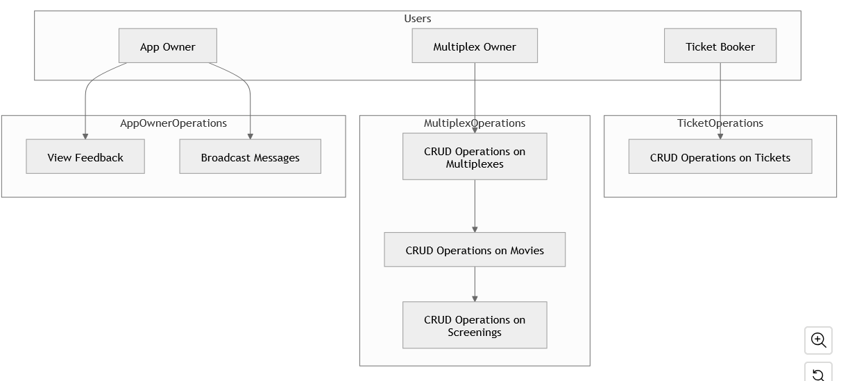
Use case diagram

Slide 8



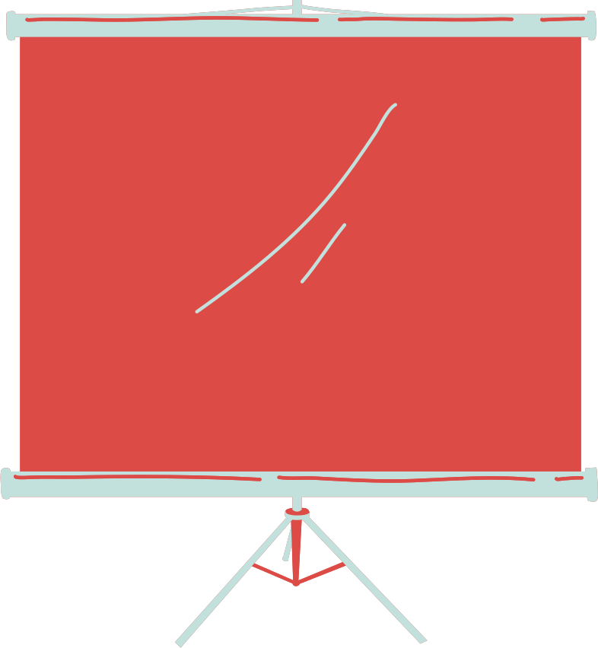
Project Flow

Slide 9
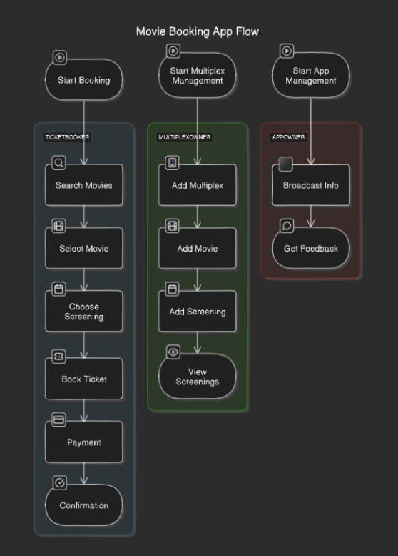
Flow Diagram for basic users

Slide 10
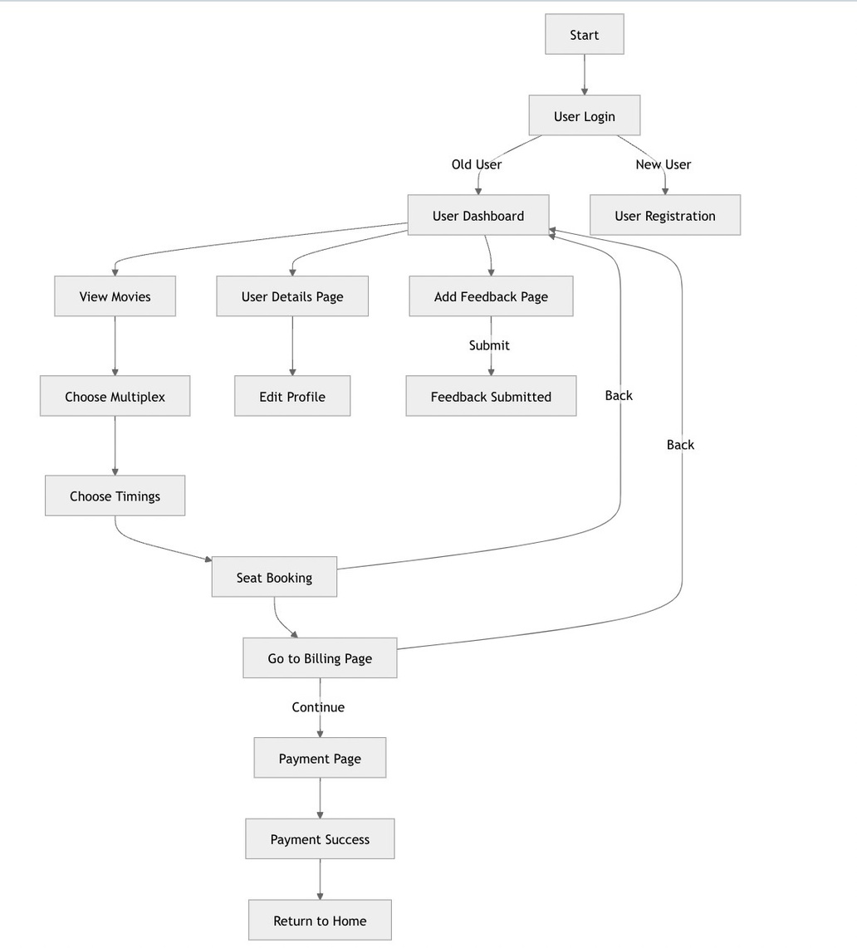
Sequence
Diagram

Slide 11
Architecture

Slide 12

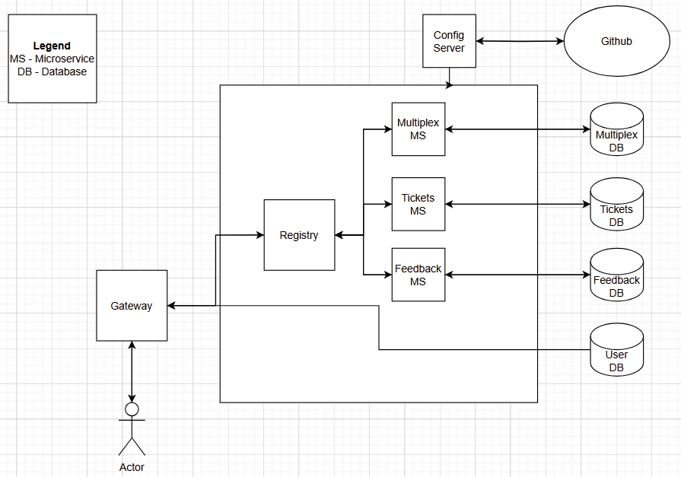
Microservice Architecture

Slide 13
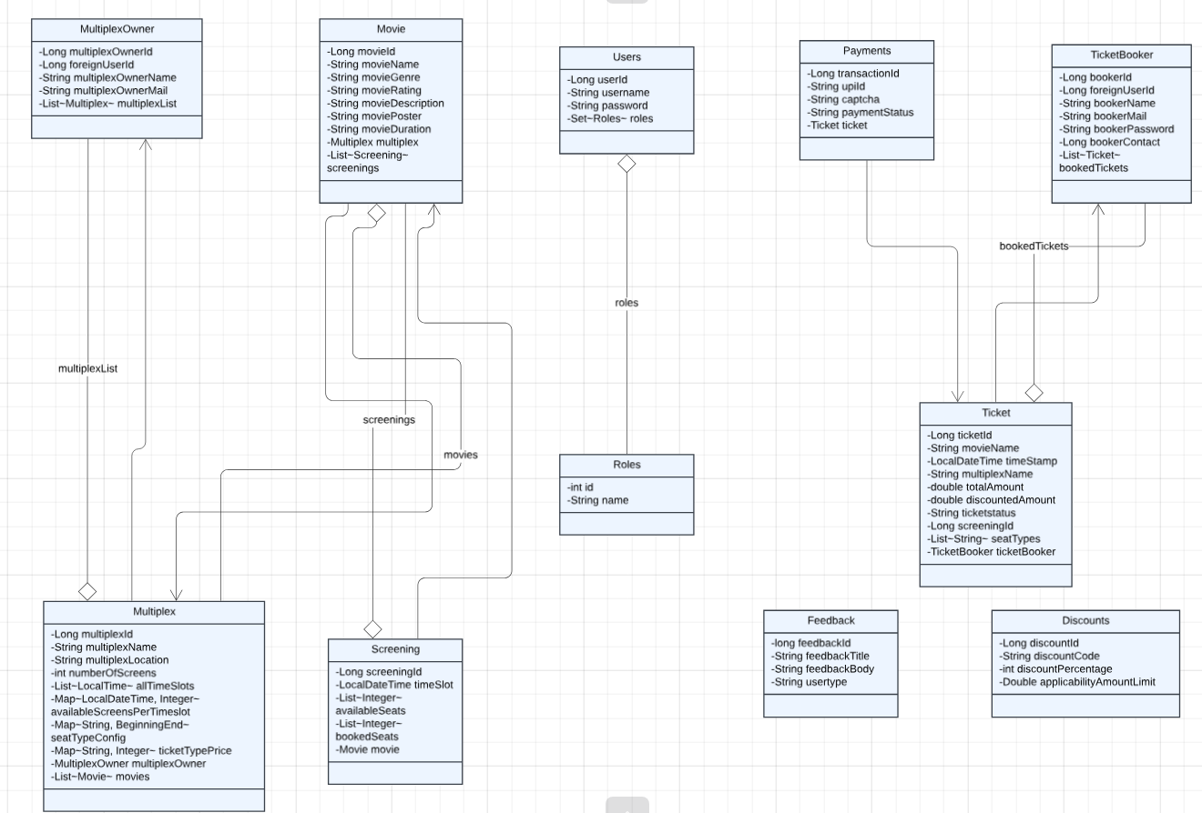
ER diagram

Slide 14
Screenshots

Slide 15
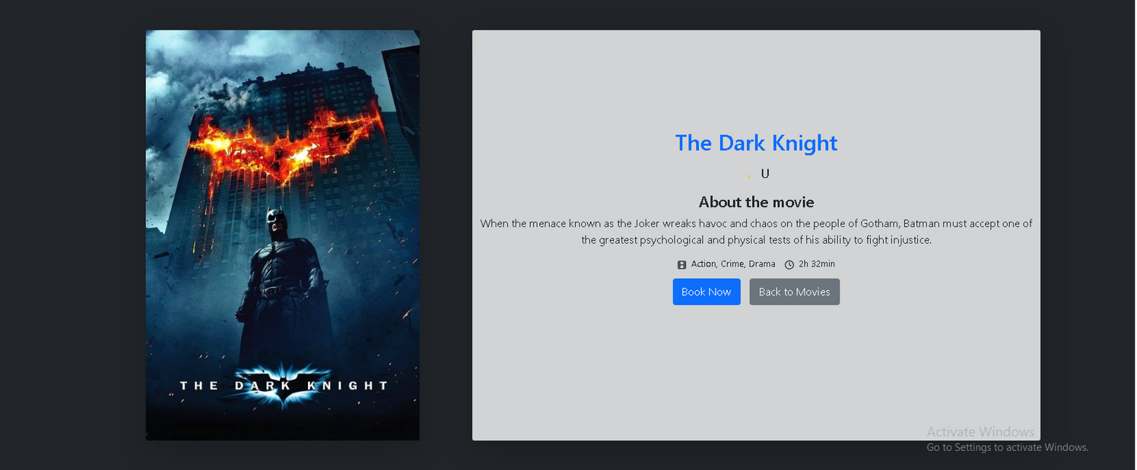
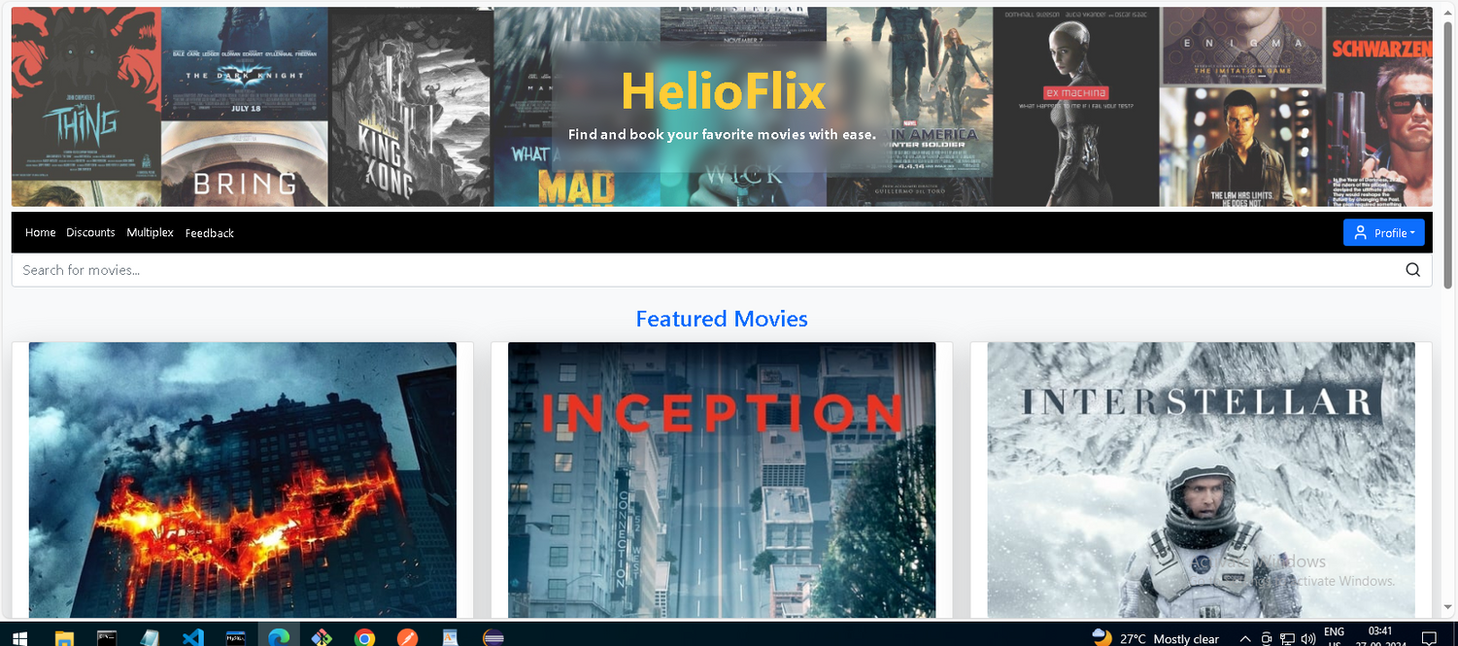
TicketBooker
Dashboard

Slide 16
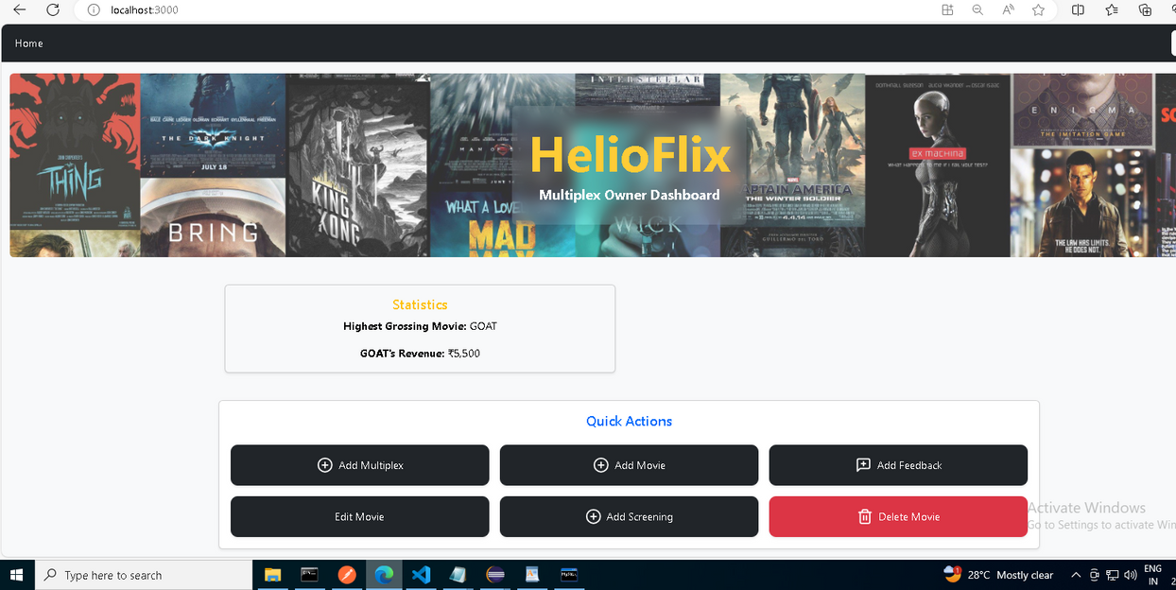
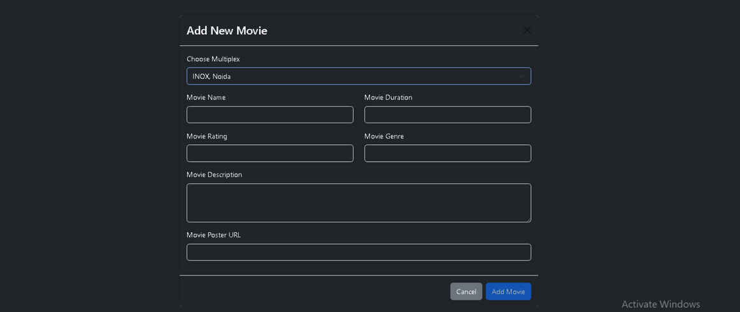
Multiplex
Owner
Dashboard

Slide 17
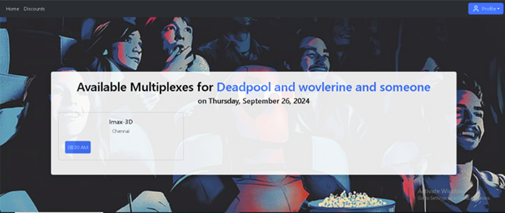
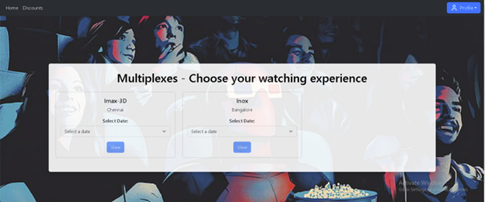
Multiplex list
and movies
in that
multiplex

Slide 18
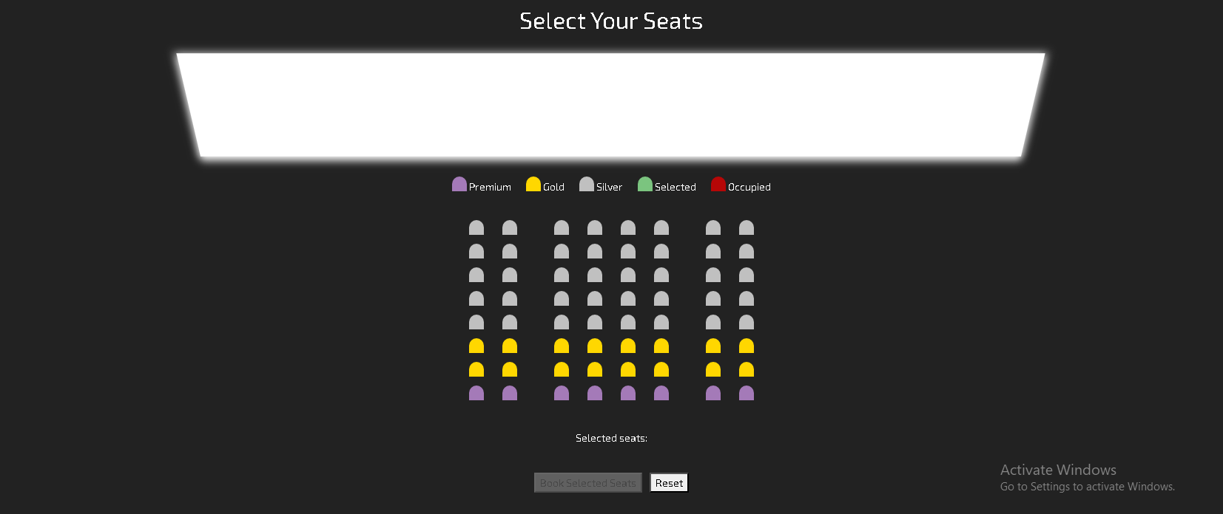
Seats selection
page

Slide 19
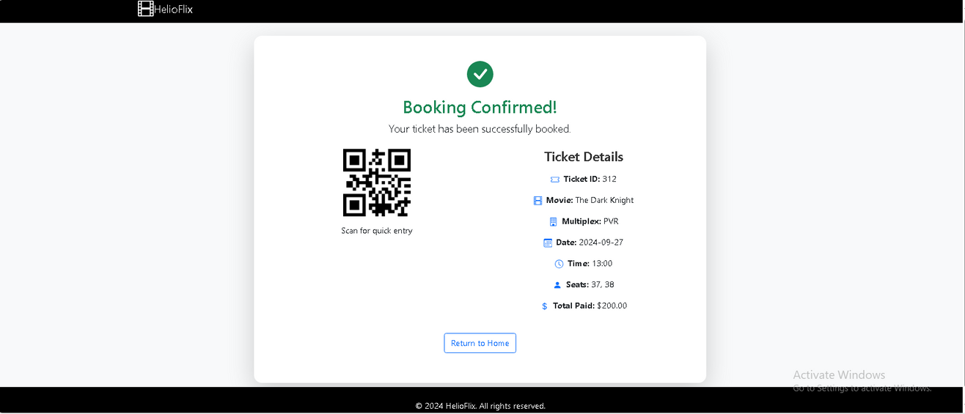
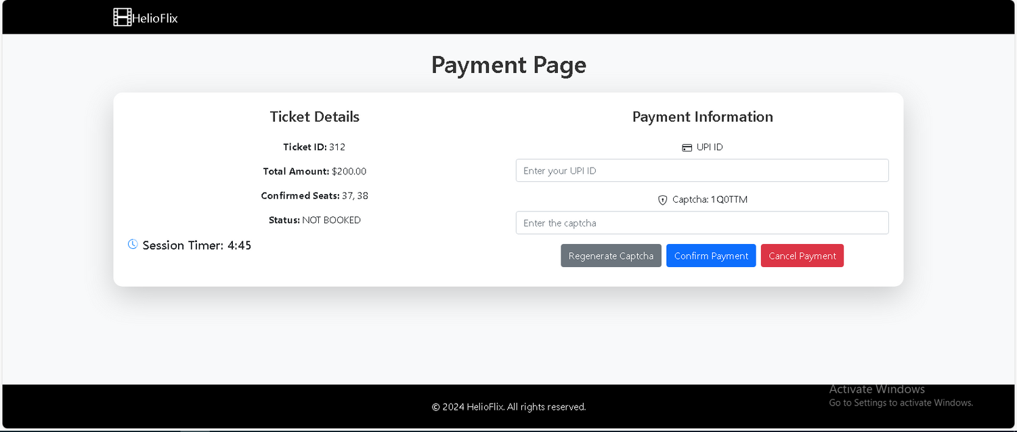
Payment and
booking
confirmation

Slide 20

Conclusion
•This movie booking app helps the user(Ticket Booker) to book the latest movies with ease.
•It helps the user(Multiplex Owner) for CRUD operations for Multiplex, Movies, Screens.

